Slide 1
Computer Security:
Principles and Practice
Fourth Edition
By: William Stallings and Lawrie Brown
Notes:
Lecture slides prepared for “Computer Security: Principles and Practice”, 4/e, by William Stallings and Lawrie Brown, Chapter 14 “IT Security Management and Risk Assessment”.

Slide 2
Chapter 14
IT Security Management
and Risk Assessment
Notes:
In previous chapters, we discussed a range of technical and administrative measures that
can be used to manage and improve the security of computer systems and networks. In
this chapter and the next, we look at the process of how to best select and implement
these measures to effectively address an organization’s security requirements. As we
noted in Chapter 1, this involves examining three fundamental questions:
1. What assets do we need to protect?
2. How are those assets threatened?
3. What can we do to counter those threats?

Slide 3
IT Security Management Overview
What assets need to be protected
How are those assets threatened
What can be done to counter those threats
Is the formal process of answering the questions:
Ensures that critical assets are sufficiently protected in a cost-effective manner
Security risk assessment is needed for each asset in the organization that requires protection
Provides the information necessary to decide what management, operational, and technical controls are needed to reduce the risks identified
Notes:
IT security management is the formal process of answering these questions, ensuring
that critical assets are sufficiently protected in a cost-effective manner. More specifically,
IT security management consists of first determining a clear view of an organization’s IT
security objectives and general risk profile. Next, an IT security risk assessment is needed
for each asset in the organization that requires protection; this assessment must answer
the three key questions listed above. It provides the information necessary to decide
what management, operational, and technical controls are needed to either reduce
the risks identified to an acceptable level or otherwise accept the resultant risk. This
chapter will consider each of these items. The process continues by selecting suitable
controls and then writing plans and procedures to ensure these necessary controls
are implemented effectively. That implementation must be monitored to determine if
the security objectives are met. The whole process must be iterated, and the plans and
procedures kept up-to-date, because of the rapid rate of change in both the technology
and the risk environment. We discuss the latter part of this process in Chapter 15. The
following chapters, then, address specific control areas relating to physical security in
Chapter 16, human factors in Chapter 17, and auditing in Chapter 18.

Slide 4
Table 14.1
ISO/IEC 27000 Series of Standards on IT Security Techniques
Notes:
The discipline of IT security management has evolved considerably over the last few
decades. This has occurred in response to the rapid growth of, and dependence on, networked
computer systems and the associated rise in risks to these systems. In the last
decade a number of national and international standards have been published. These
represent a consensus on the best practice in the field. The International Standards
Organization (ISO) has revised and consolidated a number of these standards
into the ISO 27000 series. Table 14.1 details a number of recently adopted
standards within this family. In the United States, NIST has also produced a number
of relevant standards, including NIST SP 800-18 (Guide for Developing Security
Plans for Federal Information Systems, February 2006), NIST SP 800-30 (Guide
for Conducting Risk Assessments, September 2012), and NIST SP 800-53 (Security
and Privacy Controls for Federal Information Systems and Organizations, January
2015). NIST also released the “Framework for Improving Critical Infrastructure
Cybersecurity ”in 2014, to provide guidance to organizations on systematically managing
cybersecurity risks. With the growth of concerns about corporate governance
following events such as the global financial crisis and repeated incidences of the
loss of personal information by government organizations and other businesses,
auditors for such organizations increasingly require adherence to formal standards
such as these.

Slide 5
IT Security Management
IT SECURITY MANAGEMENT: A process used to achieve and maintain appropriate levels of confidentiality, integrity, availability, accountability, authenticity, and reliability. IT security management functions include:
Determining organizational IT security objectives, strategies, and policies
Determining organizational IT security requirements
Identifying and analyzing security threats to IT assets within the organization
Identifying and analyzing risks
Specifying appropriate safeguards
Monitoring the implementation and operation of safeguards that are necessary in order to cost effectively protect the information and services within the organization
Developing and implementing a security awareness program
Detecting and reacting to incidents
Notes:
[ISO13335] provides a conceptual framework for managing security. It defines
IT security management as follows:
IT SECURITY MANAGEMENT: A process used to achieve and maintain appropriate
levels of confidentiality, integrity, availability, accountability, authenticity, and reliability.
IT security management functions include:
• determining organizational IT security objectives, strategies, and policies
• determining organizational IT security requirements
• identifying and analyzing security threats to IT assets within the organization
• identifying and analyzing risks
• specifying appropriate safeguards
• monitoring the implementation and operation of safeguards that are necessary in
order to cost effectively protect the information and services within the organization
• developing and implementing a security awareness program
• detecting and reacting to incidents

Slide 6
Notes:
This process is illustrated in Figure 14.1 (adapted from figure 1 in ISO27005 (Information security risk management, 2005) and
figure 1 in ISO13335, part 3]), with a particular
focus on the internal details relating to the risk assessment process. IT security management
needs to be a key part of an organization’s overall management plan. Similarly,
the IT security risk assessment process should be incorporated into the wider risk
assessment of all the organization’s assets and business processes. Hence, unless senior
management in an organization are aware of, and support, this process, it is unlikely
that the desired security objectives will be met and contribute appropriately to the
organization’s business outcomes. Note that IT management is not something undertaken
just once. Rather it is a cyclic process that must be repeated constantly in order
to keep pace with the rapid changes in both IT technology and the risk environment.

Slide 7
Notes:
The iterative nature of this process is a key focus of ISO 31000 (Risk management-
Principles and guidelines, 2009), and is specifically applied to the security risk management
process in ISO 27005. This standard details a model process for managing
information security that comprises the following steps:
Plan: Establish security policy, objectives, processes and procedures;
perform risk assessment; develop risk treatment plan
with appropriate selection of controls or acceptance of risk.
Do: Implement the risk treatment plan.
Check: Monitor and maintain the risk treatment plan.
Act: Maintain and improve the information security risk management
process in response to incidents, review, or identified
changes.
This process is illustrated in Figure 14.2, which can be aligned with Figure 14.1.
The outcome of this process should be that the security needs of the interested parties
are managed appropriately.

Slide 8
Organizational Context and Security Policy
Maintained and updated regularly
Using periodic security reviews
Reflect changing technical/risk environments
Examine role and importance of IT systems in organization
First examine organization’s IT security:
Objectives - wanted IT security outcomes
Strategies - how to meet objectives
Policies - identify what needs to be done
Notes:
The initial step in the IT security management process comprises an examination of
the organization’s IT security objectives, strategies, and policies in the context of the
organization’s general risk profile. This can only occur in the context of the wider
organizational objectives and policies, as part of the management of the organization.
Organizational security objectives identify what IT security outcomes should be
achieved. They need to address individual rights, legal requirements, and standards
imposed on the organization, in support of the overall organizational objectives.
Organizational security strategies identify how these objectives can be met. Organizational
security policies identify what needs to be done. These objectives, strategies, and
policies need to be maintained and regularly updated based on the results of periodic
security reviews to reflect the constantly changing technological and risk environments.
To help identify these organizational security objectives, the role and importance
of the IT systems in the organization is examined. The value of these systems
in assisting the organization achieve its goals is reviewed, not just the direct costs of
these systems. Questions that help clarify these issues include the following:
• What key aspects of the organization require IT support in order to function
efficiently?
• What tasks can only be performed with IT support?
• Which essential decisions depend on the accuracy, currency, integrity, or
availability of data managed by the IT systems?
• What data created, managed, processed, and stored by the IT systems need
protection?
• What are the consequences to the organization of a security failure in their IT
systems?
If the answers to some of the above questions show that IT systems are important
to the organization in achieving its goals, then clearly the risks to them should be
assessed and appropriate action taken to address any deficiencies identified. A list
of key organization security objectives should result from this examination.
Once the objectives are listed, some broad strategy statements can be developed.
These outline in general terms how the identified objectives will be met in a consistent
manner across the organization. The topics and details in the strategy statements
depend on the identified objectives, the size of the organization, and the importance
of the IT systems to the organization. The strategy statements should address the
approaches the organization will use to manage the security of its IT systems.

Slide 9
Security Policy
Needs to address:
Scope and purpose including relation of objectives to business, legal, regulatory requirements
IT security requirements
Assignment of responsibilities
Risk management approach
Security awareness and training
General personnel issues and any legal sanctions
Integration of security into systems development
Information classification scheme
Contingency and business continuity planning
Incident detection and handling processes
How and when policy reviewed, and change control to it
Notes:
Given the organizational security objectives and strategies, an organizational
security policy is developed that describes what the objectives and strategies are and
the process used to achieve them. The organizational or corporate security policy
may be either a single large document or, more commonly, a set of related documents.
This policy typically needs to address at least the following topics:
• The scope and purpose of the policy
• The relationship of the security objectives to the organization’s legal and
regulatory obligations, and its business objectives
• IT security requirements in terms of confidentiality, integrity, availability,
accountability, authenticity, and reliability, particularly with regard to the
views of the asset owners
• The assignment of responsibilities relating to the management of IT security
and the organizational infrastructure
• The risk management approach adopted by the organization
• How security awareness and training is to be handled
• General personnel issues, especially for those in positions of trust
• Any legal sanctions that may be imposed on staff, and the conditions under
which such penalties apply
• Integration of security into systems development and procurement
• Definition of the information classification scheme used across the organization
• Contingency and business continuity planning
• Incident detection and handling processes
• How and when this policy should be reviewed
• The method for controlling changes to this policy
The intent of the policy is to provide a clear overview of how an organization’s IT
infrastructure supports its overall business objectives in general, and more specifically
what security requirements must be provided in order to do this most
effectively.

Slide 10
Management Support
IT security policy must be supported by senior management
Need IT security officer
To provide consistent overall supervision
Liaison with senior management
Maintenance of IT security objectives, strategies, policies
Handle incidents
Management of IT security awareness and training programs
Interaction with IT project security officers
Large organizations need separate IT project security officers associated with major projects and systems
Manage security policies within their area
Notes:
It is critical that an organization’s IT security policy has full approval and buy-in
by senior management. Without this, experience shows that it is unlikely that sufficient
resources or emphasis will be given to meeting the identified objectives and achieving
a suitable security outcome. With the clear, visible support of senior management, it is
much more likely that security will be taken seriously by all levels of personnel in the
organization. This support is also evidence of concern and due diligence in the management
of the organization’s systems and the monitoring of its risk profile.
Because the responsibility for IT security is shared across the organization,
there is a risk of inconsistent implementation of security and a loss of central
monitoring and control. The various standards strongly recommend that overall
responsibility for the organization’s IT security be assigned to a single person, the
organizational IT security officer. This person should ideally have a background in
IT security. The responsibilities of this person include:
• Oversight of the IT security management process
• Liaison with senior management on IT security issues
• Maintenance of the organization’s IT security objectives, strategies, and policies
• Coordination of the response to any IT security incidents
• Management of the organization-wide IT security awareness and training
programs
• Interaction with IT project security officers
Larger organizations will need separate IT project security officers associated with
major projects and systems. Their role is to develop and maintain security policies
for their systems, develop and implement security plans relating to these systems,
handle the day-to-day monitoring of the implementation of these plans, and assist
with the investigation of incidents involving their systems.

Slide 11
Security Risk Assessment
Critical component of process
Ideally examine every organizational asset
Not feasible in practice
Approaches to identifying and mitigating risks to an organization’s IT infrastructure:
Informal
Detailed risk
Combined
Baseline
Notes:
We now turn to the key risk management component of the IT security process.
This stage is critical, because without it there is a significant chance that resources
will not be deployed where most effective. The result will be that some risks are
not addressed, leaving the organization vulnerable, while other safeguards may be
deployed without sufficient justification, wasting time and money. Ideally every
single organizational asset is examined, and every conceivable risk to it is evaluated.
If a risk is judged to be too great, then appropriate remedial controls are deployed to
reduce the risk to an acceptable level. In practice this is clearly impossible. The time
and effort required, even for large, well-resourced organizations, is clearly neither
achievable nor cost effective. Even if possible, the rapid rate of change in both IT
technologies and the wider threat environment means that any such assessment
would be obsolete as soon as it is completed, if not earlier! Clearly some form of
compromise evaluation is needed.
Another issue is the decision as to what constitutes an appropriate level of
risk to accept. In an ideal world the goal would be to eliminate all risks completely.
Again, this is simply not possible. A more realistic alternative is to expend an amount
of resources in reducing risks proportional to the potential costs to the organization
should that risk occur. This process also must take into consideration the likelihood
of the risk’s occurrence. Specifying the acceptable level of risk is simply prudent
management and means that resources expended are reasonable in the context of
the organization’s available budget, time, and personnel resources. The aim of the
risk assessment process is to provide management with the information necessary for
them to make reasonable decisions on where available resources will be deployed.
Given the wide range of organizations, from very small businesses to global
multinationals and national governments, there clearly needs to be a range of alternatives
available in performing this process. There are a range of formal standards that
detail suitable IT security risk assessment processes, including ISO 13335, ISO 27005,
ISO 31000, and NIST SP 800-30. In particular, ISO 13335 recognizes four approaches
to identifying and mitigating risks to an organization’s IT infrastructure:
• Baseline approach
• Informal approach
• Detailed risk analysis
• Combined approach
The choice among these will be determined by the resources available to the organization
and from an initial high-level risk analysis that considers how valuable the IT systems
are and how critical to the organization’s business objectives. Legal and regulatory
constraints may also require specific approaches. This information should be determined
when developing the organization’s IT security objectives, strategies, and policies.

Slide 12
Baseline Approach
Goal is to implement agreed controls to provide protection against the most common threats
Forms a good base for further security measures
Use “industry best practice”
Easy, cheap, can be replicated
Gives no special consideration to variations in risk exposure
May give too much or too little security
Generally recommended only for small organizations without the resources to implement more structured approaches
Notes:
The baseline approach to risk assessment aims to implement a basic general level
of security controls on systems using baseline documents, codes of practice, and
industry best practice . The advantages of this approach are that it doesn’t require
the expenditure of additional resources in conducting a more formal risk assessment
and that the same measures can be replicated over a range of systems. The
major disadvantage is that no special consideration is given to variations in the organization’s
risk exposure based on who they are and how their systems are used.
Also, there is a chance that the baseline level may be set either too high, leading to
expensive or restrictive security measures that may not be warranted, or set too low,
resulting in insufficient security and leaving the organization vulnerable.
The goal of the baseline approach is to implement generally agreed controls to
provide protection against the most common threats. These would include implementing
industry best practice in configuring and deploying systems, like those we discuss in
Chapter 12 on operating systems security. As such, the baseline approach forms a good
base from which further security measures can be determined. Suitable baseline recommendations
and checklists may be obtained from a range of organizations, including:
• Various national and international standards organizations
• Security-related organizations such as the CERT, NSA, and so on
• Industry sector councils or peak groups
The use of the baseline approach alone would generally be recommended only for
small organizations without the resources to implement more structured approaches.
But it will at least ensure that a basic level of security is deployed, which is not
guaranteed by the default configurations of many systems.

Slide 13
Informal Approach
Involves conducting an informal, pragmatic risk analysis on organization’s IT systems
Exploits knowledge and expertise of analyst
Fairly quick and cheap
Judgments can be made about vulnerabilities and risks that baseline approach would not address
Some risks may be incorrectly assessed
Skewed by analyst’s views, varies over time
Suitable for small to medium sized organizations where IT systems are not necessarily essential
Notes:
The informal approach involves conducting some form of informal, pragmatic risk
analysis for the organization’s IT systems. This analysis does not involve the use of
a formal, structured process, but rather exploits the knowledge and expertise of the
individuals performing this analysis. These may either be internal experts, if available,
or, alternatively, external consultants. A major advantage of this approach is
that the individuals performing the analysis require no additional skills. Hence, an
informal risk assessment can be performed relatively quickly and cheaply. In addition,
because the organization’s systems are being examined, judgments can be
made about specific vulnerabilities and risks to systems for the organization that
the baseline approach would not address. Thus more accurate and targeted controls
may be used than would be the case with the baseline approach. There are a number
of disadvantages. Because a formal process is not used, there is a chance that some
risks may not be considered appropriately, potentially leaving the organization vulnerable.
Besides, because the approach is informal, the results may be skewed by the
views and prejudices of the individuals performing the analysis. It may also result in
insufficient justification for suggested controls, leading to questions over whether
the proposed expenditure is really justified. Lastly, there may be inconsistent results
over time as a result of differing expertise in those conducting the analysis.
The use of the informal approach would generally be recommended for small
to medium-sized organizations where the IT systems are not necessarily essential to
meeting the organization’s business objectives and where additional expenditure on
risk analysis cannot be justified.

Slide 14
Detailed Risk Analysis
Most comprehensive approach
Assess using formal structured process
Number of stages
Identify threats and vulnerabilities to assets
Identify likelihood of risk occurring and consequences
Significant cost in time, resources, expertise
May be a legal requirement to use
Suitable for large organizations with IT systems critical to their business objectives
Notes:
The third and most comprehensive approach is to conduct a detailed risk assessment
of the organization’s IT systems, using a formal structured process. This provides
the greatest degree of assurance that all significant risks are identified and their
implications considered. This process involves a number of stages, including
identification of assets, identification of threats and vulnerabilities to those assets,
determination of the likelihood of the risk occurring and the consequences to the
organization should that occur, and hence the risk the organization is exposed to. With
that information, appropriate controls can be chosen and implemented to address
the risks identified. The advantages of this approach are that it provides the most
detailed examination of the security risks of an organization’s IT system, and produces
strong justification for expenditure on the controls proposed. It also provides
the best information for continuing to manage the security of these systems as they
evolve and change. The major disadvantage is the significant cost in time, resources,
and expertise needed to perform such an analysis. The time taken to perform this
analysis may also result in delays in providing suitable levels of protection for some
systems. The details of this approach are discussed in the next section.
The use of a formal, detailed risk analysis is often a legal requirement for
some government organizations and businesses providing key services to them. This
may also be the case for organizations providing key national infrastructure. For
such organizations, there is no choice but to use this approach. It may also be the
approach of choice for large organizations with IT systems critical to their business
objectives and with the resources available to perform this type of analysis.

Slide 15
Combined Approach
Combines elements of the baseline, informal, and detailed risk analysis approaches
Aim is to provide reasonable levels of protection as quickly as possible then to examine and adjust the protection controls deployed on key systems over time
Approach starts with the implementation of suitable baseline security recommendations on all systems
Next, systems either exposed to high risk levels or critical to the organization's business objectives are identified in the high-level risk assessment
A decision can then be made to possibly conduct an immediate informal risk assessment on key systems, with the aim of relatively quickly tailoring controls to more accurately reflect their requirements
Lastly, an ordered process of performing detailed risk analyses of these systems can be instituted
Over time, this can result in the most appropriate and cost-effective security controls being selected and implemented on these systems
Notes:
The last approach combines elements of the baseline, informal, and detailed risk
analysis approaches. The aim is to provide reasonable levels of protection as quickly
as possible, and then to examine and adjust the protection controls deployed on key
systems over time. The approach starts with the implementation of suitable baseline
security recommendations on all systems. Next, systems either exposed to high risk
levels or critical to the organization’s business objectives are identified in the high-level
risk assessment. A decision can then be made to possibly conduct an immediate
informal risk assessment on key systems, with the aim of relatively quickly
tailoring controls to more accurately reflect their requirements. Lastly, an ordered
process of performing detailed risk analyses of these systems can be instituted. Over
time this can result in the most appropriate and cost-effective security controls being
selected and implemented on these systems. This approach has a significant number
of advantages. The use of the initial high-level analysis to determine where further
resources need to be expended, rather than facing a full detailed risk analysis of
all systems, may well be easier to sell to management. It also results in the development
of a strategic picture of the IT resources and where major risks are likely
to occur. This provides a key planning aid in the subsequent management of the
organization’s security. The use of the baseline and informal analyses ensures that a
basic level of security protection is implemented early. And it means that resources
are likely to be applied where most needed and that systems most at risk are likely
to be examined further reasonably early in the process. However, there are some
disadvantages. If the initial high-level analysis is inaccurate, then some systems for
which a detailed risk analysis should be performed may remain vulnerable for some
time. Nonetheless, the use of the baseline approach should ensure a basic minimum
security level on such systems. Further, if the results of the high-level analysis are
reviewed appropriately, the chance of lingering vulnerability is minimized.
ISO13335 considers that for most organizations, in most circumstances, this
approach is the most cost effective. Consequently its use is highly recommended.

Slide 16
Detailed Security Risk Analysis
Provides the most accurate evaluation of an organization's IT system’s security risks
Highest cost
Initially focused on addressing defense security concerns
Often mandated by government organizations and associated businesses
Notes:
The formal, detailed security risk analysis approach provides the most accurate
evaluation of an organization’s IT system’s security risks, but at the highest cost.
This approach has evolved with the development of trusted computer systems,
initially focused on addressing defense security concerns, as we discuss in Chapter 13 .
The original security risk assessment methodology was given in the Yellow Book
standard (CSC-STD-004-85 June 1985), one of the original U.S. TCSEC rainbow
book series of standards. Its focus was entirely on protecting the confidentiality of
information, reflecting the military concern with information classification. The
recommended rating it gave for a trusted computer system depended on difference
between the minimum user clearance and the maximum information classification.
Specifically it defined a risk index as
Risk Index = Max Info Sensitivity - Min User Clearance
A table in this standard, listing suitable categories of systems for each risk level,
was used to select the system type. Clearly this limited approach neither adequately
reflects the range of security services required nor the wide range of possible threats.
Over the years since, the process of conducting a security risk assessment that does
consider these issues has evolved.

Slide 17
Notes:
A number of national and international standards document the expected formal
risk analysis approach. These include ISO 27005, ISO 31000, NIST SP 800-30,
and [SASN13]. This approach is often mandated by government organizations
and associated businesses. These standards all broadly agree on the process used.
Figure 14.3 (reproduced from figure 5 in NIST SP 800-30) illustrates a typical
process used.

Slide 18
Establishing the Context
Initial step
Determine the basic parameters of the risk assessment
Identify the assets to be examined
Explores political and social environment in which the organization operates
Legal and regulatory constraints
Provide baseline for organization’s risk exposure
Risk appetite
The level of risk the organization views as acceptable
Notes:
The initial step is known as establishing the context or system characterization . Its
purpose is to determine the basic parameters within which the risk assessment will
be conducted, and then to identify the assets to be examined.
The process starts with the organizational
security objectives and considers the broad risk exposure of the organization. This
recognizes that not all organizations are equally at risk, but that some, because of
their function, may be specifically targeted. It explores the relationship between
a specific organization and the wider political and social environment in which
it operates.
Industries such as agriculture and education are
considered to be at lesser risk compared to government or banking and finance. Note
that this classification predates September 11, and it is likely that there has been
change since it was developed. In particular it is likely that utilities, for example,
are probably at higher risk than the classification suggests. NIST has indicated that
the following industries are vulnerable to risks in Supervisory Control and Data
Acquisition (SCADA) and process control systems: electric, water and wastewater,
oil and natural gas, chemical, pharmaceutical, pulp and paper, food and beverage,
discrete manufacturing (automotive, aerospace, and durable goods), air and rail
transportation, and mining and metallurgy.
At this point in determining an organization’s broad risk exposure, any relevant
legal and regulatory constraints must also be identified. These features provide
a baseline for the organization’s risk exposure and an initial indication of the broad
scale of resources it needs to expend to manage this risk in order to successfully
conduct business.
Next, senior management must define the organization’s risk appetite , the
level of risk the organization views as acceptable. Again this will depend very much
on the type of organization, and its management’s attitude to how it conducts business.
For example, banking and finance organizations tend to be fairly conservative
and risk averse. This means they want a low residual risk and are willing to spend
the resources necessary to achieve this. In contrast, a leading-edge manufacturer
with a brand new product may have a much greater risk tolerance. The manufacturer
is willing to take a chance to obtain a competitive advantage, and with limited
resources wishes to expend less on risk controls. This decision is not just IT specific.
Rather it reflects the organization’s broader management approach to how it conducts
business.

Slide 19
Notes:
Figure 14.4 (adapted from an IDC 2000 report) suggests a possible
spectrum of organizational risk.

Slide 20
Asset Identification
Last component is to identify assets to examine
Draw on expertise of people in relevant areas of organization to identify key assets
Identify and interview such personnel
Asset
“anything that needs to be protected” because it has value to the organization and contributes to the successful attainment of the organization’s objectives
Notes:
The last component of this first step in the risk
assessment is to identify the assets to examine. This directly addresses the first of
the three fundamental questions we opened this chapter with: “What assets do
we need to protect?” An asset is “anything that needs to be protected” because
it has value to the organization and contributes to the successful attainment of
the organization’s objectives. As we discuss in Chapter 1, an asset may be either
tangible or intangible. It includes computer and communications hardware
infrastructure, software (including applications and information/data held on these
systems), the documentation on these systems, and the people who manage and
maintain these systems. Within the boundaries identified for the risk assessment,
these assets need to be identified and their value to the organization assessed. It is
important to emphasize again that while the ideal is to consider every conceivable
asset, in practice this is not possible. Rather the goal here is to identify all assets
that contribute significantly to attaining the organization’s objectives and whose
compromise or loss would seriously impact on the organization’s operation.
[SASN13] describes this process as a criticality assessment that aims to identify
those assets that are most important to the organization.
While the risk assessment process is most likely being managed by security
experts, they will not necessarily have a high degree of familiarity with the
organization’s operation and structures. Thus they need to draw on the expertise
of the people in the relevant areas of the organization to identify key assets and
their value to the organization. A key element of this process step is identifying
and interviewing such personnel. Many of the standards listed previously include
checklists of types of assets and suggestions for mechanisms for gathering the
necessary information. These should be consulted and used. The outcome of this
step should be a list of assets, with brief descriptions of their use by, and value to,
the organization.

Slide 21
Terminology
Asset: A system resource or capability of value to its owner that requires protection
Threat: A potential for a threat source to exploit a vulnerability in some asset, which if it occurs may compromise the security of the asset and cause harm to the asset’s owner
Vulnerability: A flaw or weakness in an asset’s design, implementation, or operation and management that could be exploited by some threat
Risk: The potential for loss computed as the combination of the likelihood that a given threat exploits some vulnerability to an asset, and the magnitude of harmful consequence that results to the asset’s owner
Notes:
The next step in the process is to identify the threats or risks the assets are exposed
to. This directly addresses the second of our three fundamental questions: “How
are those assets threatened?” It is worth commenting on the terminology used here.
The terms threat and risk, while having distinct meanings, are often used interchangeably
in this context. There is considerable variation in the definitions of these
terms, as seen in the range of definitions provided in the cited standards. The following
definitions will be useful in our discussion:
The relationship among these and other security concepts is illustrated in Figure 1.2.
The goal of this stage is to identify potentially significant risks to the assets
listed. This requires answering the following questions for each asset:
1. Who or what could cause it harm?
2. How could this occur?

Slide 22
Threat Identification
Availability
Authenticity
Reliability
Accountability
Integrity
Anything that might hinder or prevent an asset from providing appropriate levels of the key security services
Confidentiality
A threat is:
Notes:
Answering the first of these questions involves
identifying potential threats to assets. In the broadest sense, a threat is anything
that might hinder or prevent an asset from providing appropriate levels of the key
security services: confidentiality, integrity, availability, accountability, authenticity,
and reliability. Note that one asset may have multiple threats, and a single threat
may target multiple assets.

Slide 23
Threat Sources
Threats may be
Natural “acts of God”
Man-made
Accidental or deliberate
Any previous experience of attacks seen by the organization also needs to be considered
Evaluation of human threat sources should consider:
Motivation
Capability
Resources
Probability of attack
Deterrence
Notes:
A threat may be either natural or human-made and may be accidental or
deliberate. This is known as the threat source or threat agent. The classic natural threat sources are
those often referred to as acts of God, and include damage caused by fire, flood,
storm, earthquake, and other such natural events. It also includes environmental
threats such as long-term loss of power or natural gas. Or it may be the result of
chemical contamination or leakage. Alternatively, a threat source may be a human
agent acting either directly or indirectly. Examples of the former include an insider
retrieving and selling information for personal gain or a hacker targeting the organization’s
server over the Internet. An example of the latter includes someone writing
and releasing a network worm that infects the organization’s systems. These
examples all involved a deliberate exploit of a threat. However, a threat may also
be a result of an accident, such as an employee incorrectly entering information on
a system, which results in the system malfunctioning.
Identifying possible threats and threat sources requires the use of a variety of
sources, along with the experience of the risk assessor. The chance of natural threats
occurring in any particular area is usually well known from insurance statistics. Lists
of other potential threats may be found in the standards, in the results of IT security
surveys, and in information from government security agencies. The annual computer
crime reports, such as those by CSI/FBI and by Verizon in the United States,
and similar reports in other countries, provide useful general guidance on the broad
IT threat environment and the most common problem areas. Standards, such as
NIST SP 800-30 Appendix D with a taxonomy of threat sources, and Appendix E with
examples of threats, may also assist here.
However, this general guidance needs to be tailored to the organization and
the risk environment it operates in. This involves consideration of vulnerabilities in
the organization’s IT systems, which may indicate that some risks are either more or
less likely than the general case. Where an organization’s security concerns are sufficiently
high that threats need to be specifically identified, threat scenarios can be
modelled, developed, and analyzed, as described in NIST SP 800-30. Organization’s define
threat scenarios to describe how the tactics, techniques, and procedures employed
by an attacker can contribute to, or cause, harm. The possible motivation of deliberate
attackers in relation to the organization should be considered as potentially
influencing this variation in risk. In addition, any previous experience of attacks seen
by the organization needs to be considered, as that is concrete evidence of risks that
are known to occur. When evaluating possible human threat sources, it is worth considering
their reason and capabilities for attacking this organization, including their:
• Motivation: Why would they target this organization; how motivated are they?
• Capability: What is their level of skill in exploiting the threat?
• Resources: How much time, money, and other resources could they deploy?
• Probability of attack: How likely and how often would your assets be targeted?
• Deterrence: What are the consequences to the attacker of being identified?

Slide 24
Vulnerability Identification
Identify exploitable flaws or weaknesses in organization’s IT systems or processes
Determines applicability and significance of threat to organization
Need combination of threat and vulnerability to create a risk to an asset
Outcome should be a list of threats and vulnerabilities with brief descriptions of how and why they might occur
Notes:
Answering the second of these questions, “How
could this occur?” involves identifying flaws or weaknesses in the organization’s IT
systems or processes that could be exploited by a threat. This will help determine
the applicability of the threat to the organization and its significance. Note that
the mere existence of some vulnerability does not mean harm will be caused to
an asset. There must also be a threat source for some threat that can exploit the
vulnerability for harm. It is the combination of a threat and a vulnerability that
creates a risk to an asset.
Again, many of the standards listed previously include checklists of threats
and vulnerabilities and suggestions for tools and techniques to list them and to
determine their relevance to the organization. The outcome of this step should be
a list of threats and vulnerabilities, with brief descriptions of how and why they
might occur.

Slide 25
Analyze Risks
Specify likelihood of occurrence of each identified threat to asset given existing controls
Specify consequence should threat occur
Derive overall risk rating for each threat
Risk = probability threat occurs x cost to organization
Hard to determine accurate probabilities and realistic cost consequences
Use qualitative, not quantitative, ratings
Notes:
Having identified key assets and the likely threats and vulnerabilities they are
exposed to, the next step is to determine the level of risk each of these poses to the
organization. The aim is to identify and categorize the risks to assets that threaten
the regular operations of the organization. Risk analysis also provides information
to management to help managers evaluate these risks and determine how best to
treat them. Risk analysis involves first specifying the likelihood of occurrence of
each identified threat to an asset, in the context of any existing controls. Next, the
consequence to the organization is determined, should that threat eventuate. Lastly,
this information is combined to derive an overall risk rating for each threat. The
ideal would be to specify the likelihood as a probability value and the consequence
as a monetary cost to the organization should it occur. The resulting risk is then
simply given as
Risk = (Probability that threat occurs) x (Cost to organization)
This can be directly equated to the value the threatened asset has for the organization,
and hence specify what level of expenditure is reasonable to reduce the
probability of its occurrence to an acceptable level. Unfortunately, it is often
extremely hard to determine accurate probabilities, realistic cost consequences,
or both. This is particularly true of intangible assets, such as the loss of confidentiality
of a trade secret. Hence, most risk analyses use qualitative, rather than
quantitative, ratings for both these items. The goal is then to order the resulting
risks to help determine which need to be most urgently treated, rather than to
give them an absolute value.

Slide 26
Analyze Existing Controls
Existing controls used to attempt to minimize threats need to be identified
Security controls include:
Management
Operational
Technical processes and procedures
Use checklists of existing controls and interview key organizational staff to solicit information
Notes:
Before the likelihood of a threat can be specified,
any existing controls used by the organization to attempt to minimize threats need
to be identified. Security controls include management, operational, and technical
processes and procedures that act to reduce the exposure of the organization to
some risks by reducing the ability of a threat source to exploit some vulnerabilities.
These can be identified by using checklists of existing controls, and by interviewing
key organizational staff to solicit this information.

Slide 27
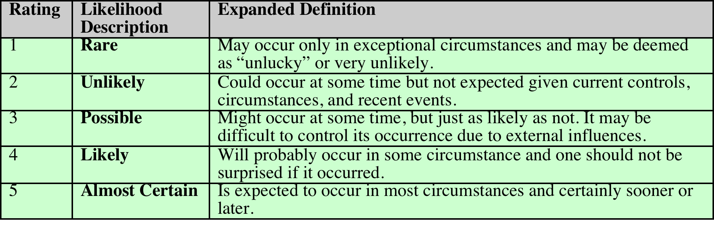
Table 14.2
Risk Likelihood
Notes:
Having identified existing controls, the likelihood
that each identified threat could occur and cause harm to some asset needs to
be specified. The likelihood is typically described qualitatively, using values and
descriptions such as those shown in Table 14.2. While the various risk assessment
standards all suggest tables similar to these, there is considerable variation in their
detail. The selection of the specific descriptions and tables used is determined at
the beginning of the risk assessment process, when the context is established.
There will very likely be some uncertainty and debate over exactly which rating
is most appropriate. This reflects the qualitative nature of the ratings, ambiguity
in their precise meaning, and uncertainty over precisely how likely it is that some
threat may eventuate. It is important to remember that the goal of this process is
to provide guidance to management as to which risks exist, and provide enough
information to help management decide how to most appropriately respond. Any
uncertainty in the selection of ratings should be noted in the discussion on their
selection, but ultimately management will make a business decision in response to
this information.
The risk analyst takes the descriptive asset and threat/vulnerability details
from the preceding steps in this process and, in light of the organization’s overall
risk environment and existing controls, decides the appropriate rating. This
estimation relates to the likelihood of the specified threat exploiting one or
more vulnerabilities to an asset or group of assets, which results in harm to the
organization. The specified likelihood needs to be realistic. In particular, a rating
of likely or higher suggests that this threat has occurred sometime previously. This
means past history provides supporting evidence for its specification. If this is
not the case, then specifying such a value would need to be justified on the basis
of a significantly changed threat environment, a change in the IT system that
has weakened its security, or some other rationale for the threat’s anticipated
likely occurrence. In contrast, the Unlikely and Rare ratings can be very hard to
quantify. They are an indication that the threat is of concern, but whether it could
occur is difficult to specify. Typically such threats would only be considered if the
consequences to the organization of their occurrence are so severe that they must
be considered, even if extremely improbable.

Slide 28
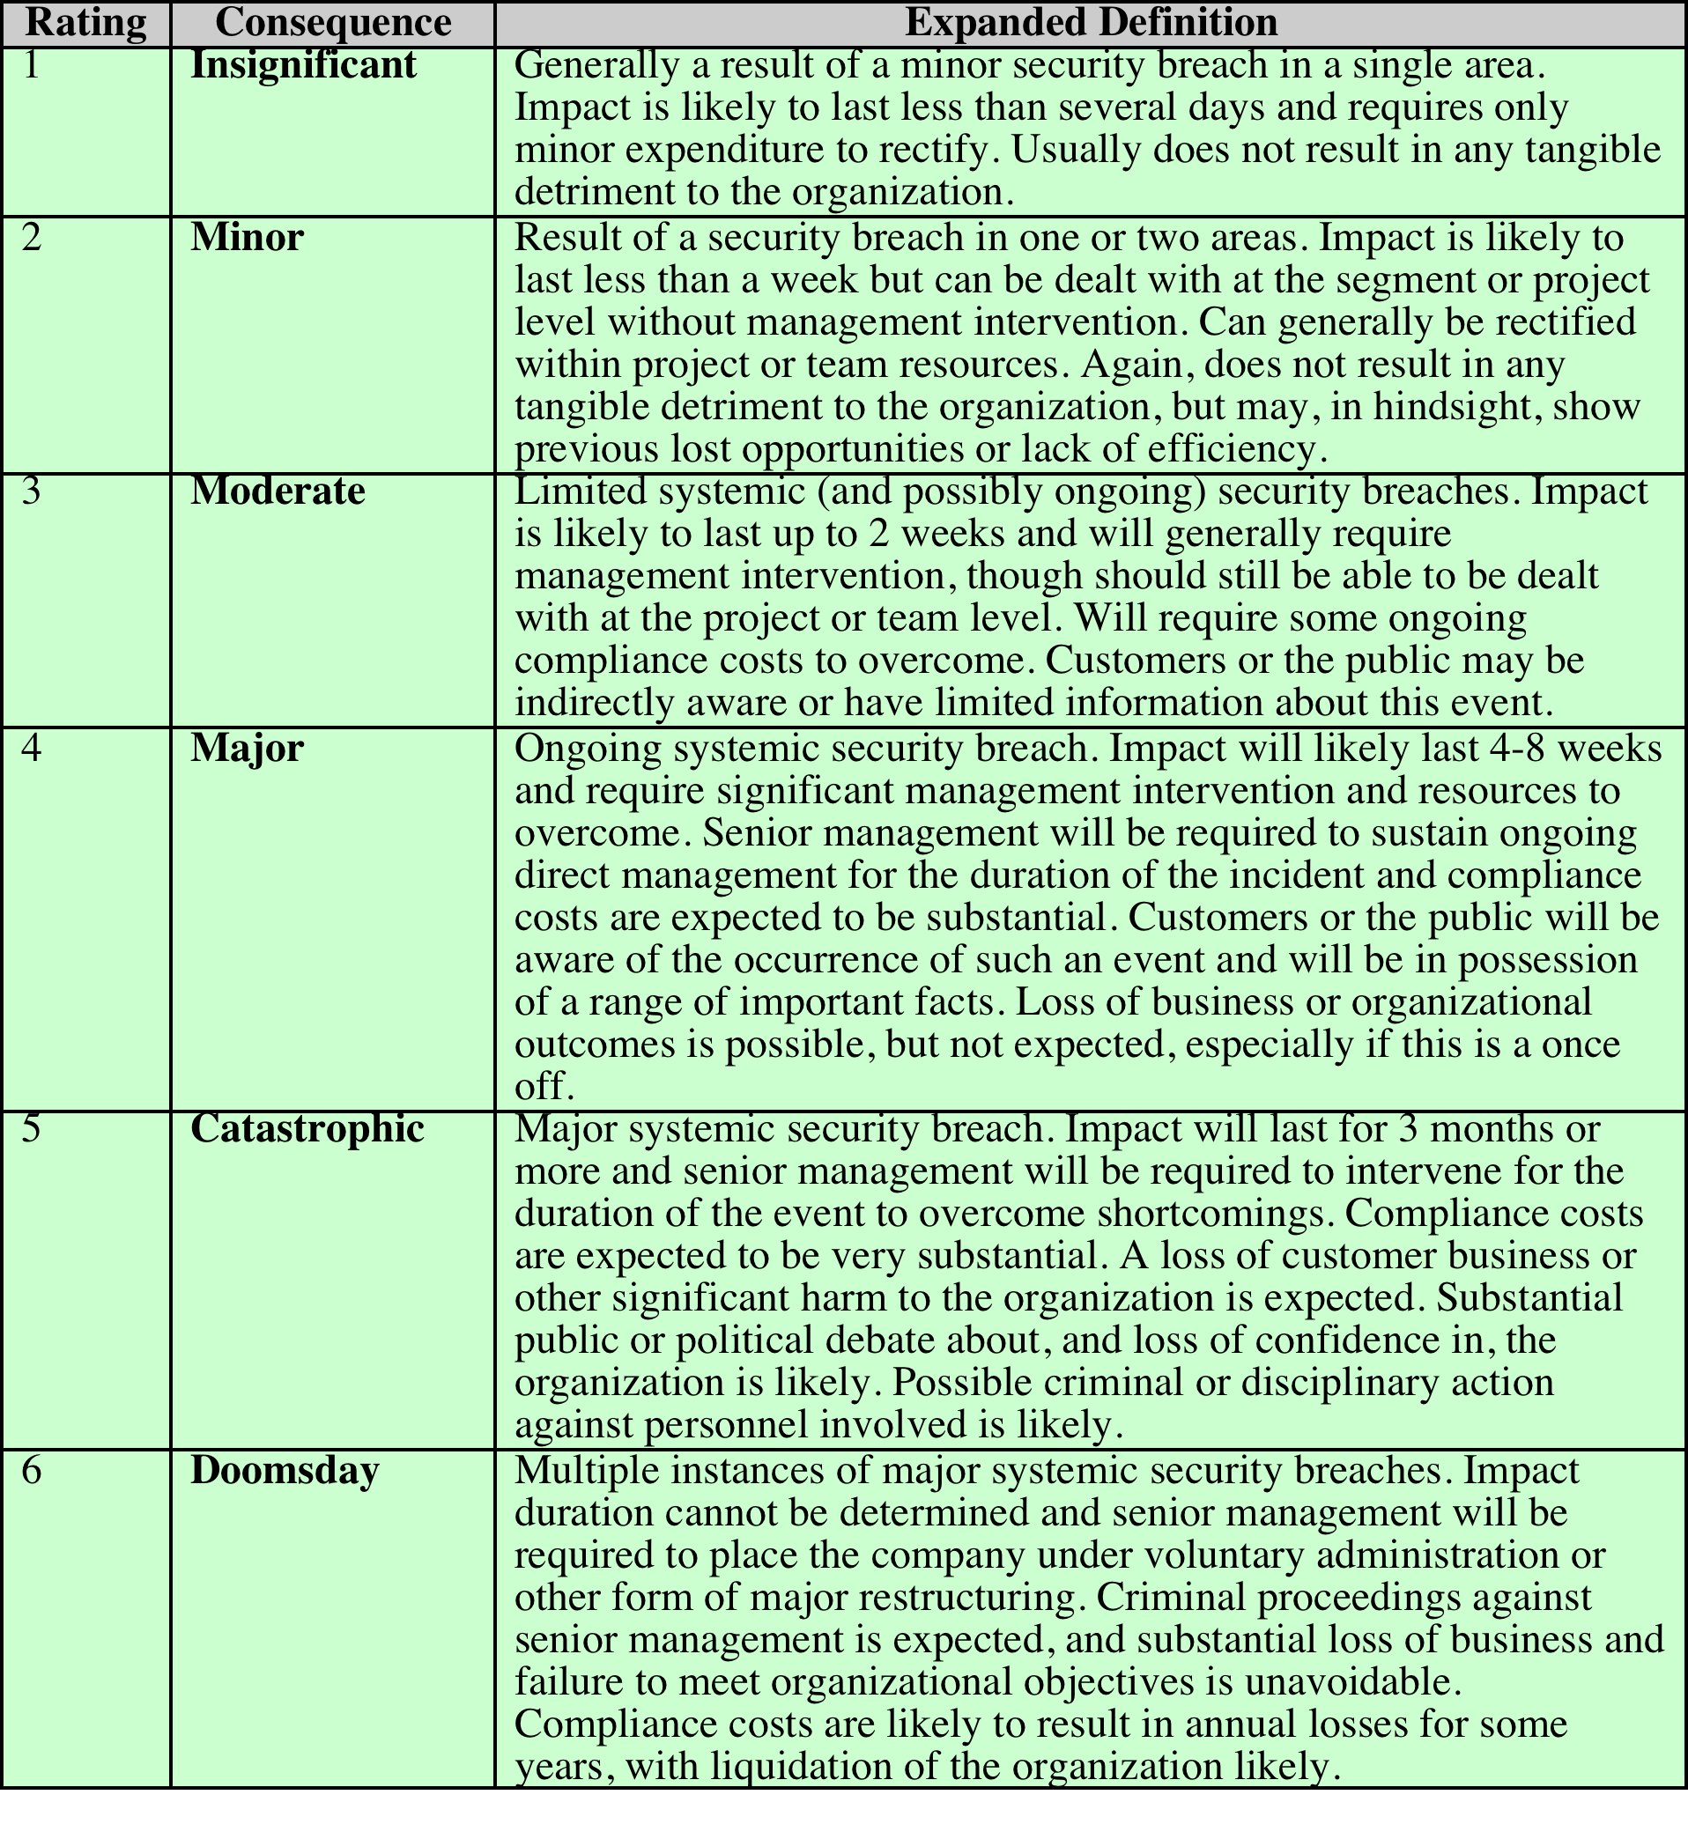
Table 14.3 Risk Consequences
(Table can be found on pages
476-477 in textbook)
Notes:
The analyst must then
specify the consequence of a specific threat eventuating. Note this is distinct from,
and not related to, the likelihood of the threat occurring. Rather, consequence
specification indicates the impact on the organization should the particular threat
in question actually eventuate. Even if a threat is regarded as rare or unlikely, if
the organization would suffer severe consequence should it occur, then it clearly
poses a risk to the organization. Hence, appropriate responses must be considered.
A qualitative descriptive value, such as those shown in Table 14.3, is typically used
to describe the consequence. As with the likelihood ratings, there is likely to be
some uncertainty as to the best rating to use.
This determination should be based upon the judgment of the asset’s owners,
and the organization’s management, rather than the opinion of the risk analyst. This
is in contrast with the likelihood determination. The specified consequence needs to
be realistic. It must relate to the impact on the organization as a whole should this
specific threat eventuate. It is not just the impact on the affected system. It is possible
that a particular system (a server in one location, for example) might be completely
destroyed in a fire. However, the impact on the organization could vary from it being
a minor inconvenience (the server was in a branch office, and all data were replicated
elsewhere) to a major disaster (the server had the sole copy of all customer
and financial records for a small business). As with the likelihood ratings, the consequence
ratings must be determined knowing the organization’s current practices and
arrangements. In particular, the organization’s existing backup, disaster recovery,
and contingency planning, or lack thereof, will influence the choice of rating.

Slide 29
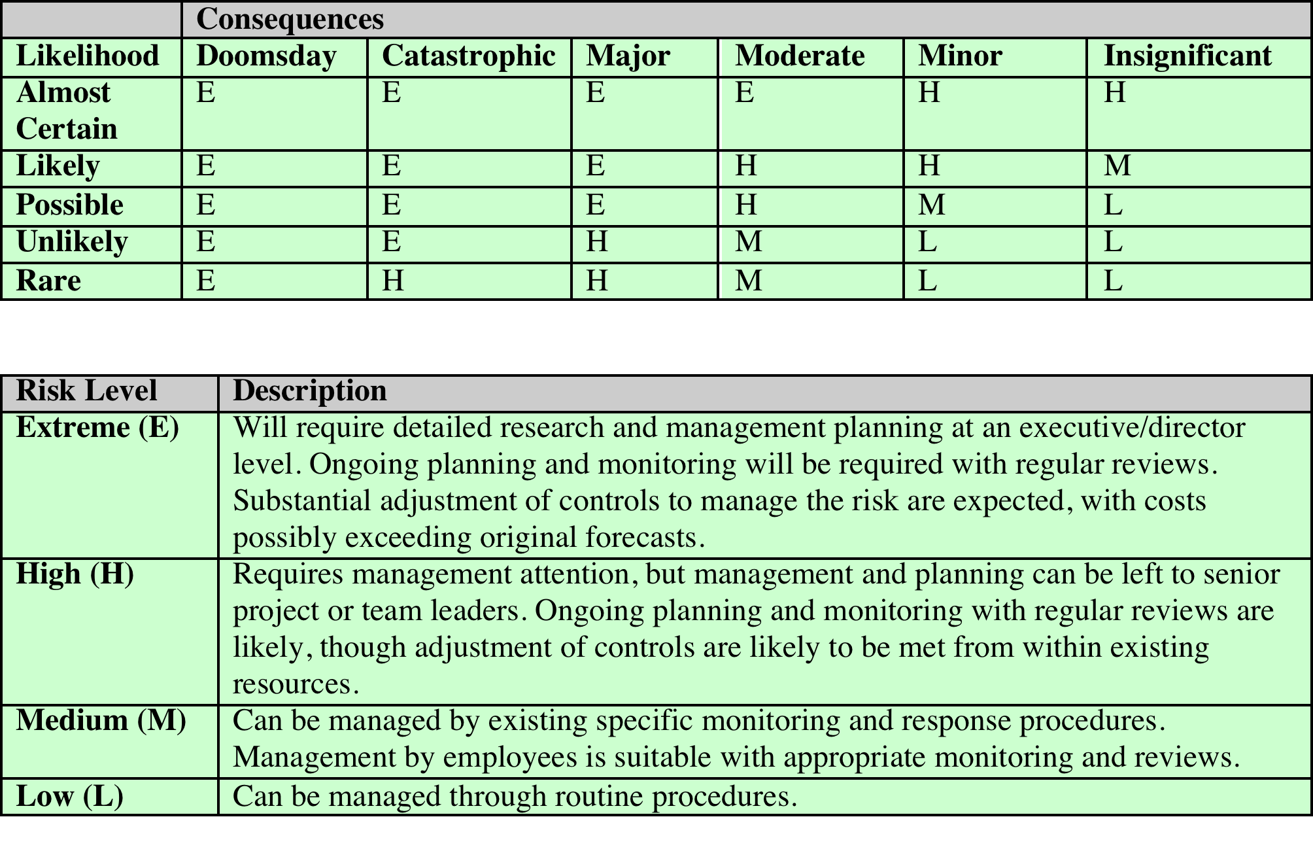
Table 14.4 Risk Level Determination and Meaning
Notes:
Once the likelihood and consequence
of each specific threat have been identified, a final level of risk can be assigned.
This is typically determined using a table that maps these values to a risk level,
such as those shown in Table 14.4. This table details the risk level assigned to each
combination. Such a table provides the qualitative equivalent of performing the
ideal risk calculation using quantitative values. It also indicates the interpretation
of these assigned levels.

Slide 30
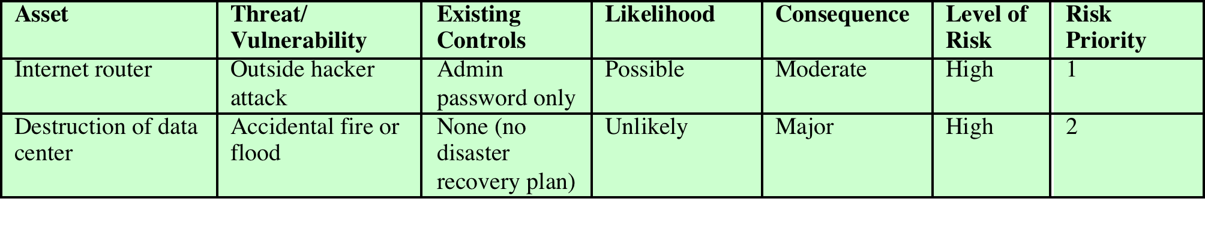
Table 14.5 Risk Register
Notes:
The results of the risk analysis
process should be documented in a risk register. This should include a summary
table such that shown in Table 14.5 . The risks are usually sorted in decreasing
order of level. This would be supported by details of how the various items
were determined, including the rationale, justification, and supporting evidence
used. The aim of this documentation is to provide senior management with
the information needed to make appropriate decisions as how to best manage
the identified risks. It also provides evidence that a formal risk assessment process
has been followed if needed, and a record of decisions made with the reasons for
those decisions.
Once the details of potentially significant risks are determined, management needs
to decide whether it needs to take action in response. This would take into account
the risk profile of the organization and its willingness to accept a certain level of
risk, as determined in the initial establishing the context phase of this process. Those
items with risk levels below the acceptable level would usually be accepted with no
further action required. Those items with risks above this will need to be considered
for treatment.

Slide 31
Notes:
Typically the risks with the higher ratings are those that need action most urgently.
However, it is likely that some risks will be easier, faster, and cheaper to address
than others. In the example risk register shown in Table 14.5, both risks were rated
High. Further investigation reveals that a relatively simple and cheap treatment
exists for the first risk by tightening the router configuration to further restrict possible
accesses. Treating the second risk requires developing a full disaster recovery
plan, a much slower and more costly process. Hence management would take the
simple action first to improve the organization’s overall risk profile as quickly as
possible. Management may even decide that for business reasons, given an overall
view of the organization, some risks with lower levels should be treated ahead of
other risks. This is a reflection of both limitations in the risk analysis process in the
range of ratings available and their interpretation, and of management’s perspective
of the organization as a whole.
Figure 14.5 indicates a range of possibilities for costs versus levels of risk.
If the cost of treatment is high, but the risk is low, then it is usually uneconomic
to proceed with such treatment. Alternatively, where the risk is high and the cost
comparatively low, treatment should occur. The most difficult area occurs between
these extremes. This is where management must make a business decision about the
most effective use of their available resources. This decision usually requires a more
detailed investigation of the treatment options.

Slide 32
Risk Treatment Alternatives
Risk acceptance
Choosing to accept a risk level greater than normal for business reasons
Risk avoidance
Not proceeding with the activity or system that creates this risk
Risk transfer
Sharing responsibility for the risk with a third party
Reduce consequence
Modifying the structure or use of the assets at risk to reduce the impact on the organization should the risk occur
Reduce likelihood
Implement suitable controls to lower the chance of the vulnerability being exploited
Notes:
There are five broad alternatives
available to management for treating identified risks:
Risk acceptance: Choosing to accept a risk level greater than normal for business
reasons. This is typically due to excessive cost or time needed to treat the
risk. Management must then accept responsibility for the consequences to the
organization should the risk eventuate.
• Risk avoidance: Not proceeding with the activity or system that creates this
risk. This usually results in loss of convenience or ability to perform some
function that is useful to the organization. The loss of this capability is traded
off against the reduced risk profile.
• Risk transfer: Sharing responsibility for the risk with a third party. This is
typically achieved by taking out insurance against the risk occurring, by entering
into a contract with another organization, or by using partnership or joint
venture structures to share the risks and costs should the threat eventuate.
• Reduce consequence: By modifying the structure or use of the assets at risk
to reduce the impact on the organization should the risk occur. This could
be achieved by implementing controls to enable the organization to quickly
recover should the risk occur. Examples include implementing an off-site
backup process, developing a disaster recovery plan, or arranging for data and
processing to be replicated over multiple sites.
• Reduce likelihood: By implementing suitable controls to lower the chance of
the vulnerability being exploited. These could include technical or administrative
controls such as deploying firewalls and access tokens, or procedures such
as password complexity and change policies. Such controls aim to improve the
security of the asset, making it more difficult for an attack to succeed by reducing the
vulnerability of the asset.
If either of the last two options is chosen, then possible treatment controls
need to be selected and their cost effectiveness evaluated. There is a wide range
of available management, operational, and technical controls that may be used.
These would be surveyed to select those that might address the identified threat
most effectively and to evaluate the cost to implement against the benefit gained.
Management would then choose among the options as to which should be adopted
and plan for their implementation. We introduce the range of controls often used
and the use of security plans and policies in Chapter 15 and provide further details
of some specific control areas in Chapters 16 – 18 .

Slide 33
Case Study: Silver Star Mines
Fictional operation of global mining company
Large IT infrastructure
Both common and specific software
Some directly relates to health and safety
Formerly isolated systems now networked
Decided on combined approach
Mining industry less risky end of spectrum
Subject to legal/regulatory requirements
Management accepts moderate or low risk
Notes:
A case study involving the operations of a fictional company Silver Star Mines illustrates
this risk assessment process. Silver Star Mines is the local operations of a large global
mining company. It has a large IT infrastructure used by numerous business areas.
Its network includes a variety of servers, executing a range of application software
typical of organizations of its size. It also uses applications that are far less common,
some of which directly relate to the health and safety of those working in the mine.
Many of these systems used to be isolated, with no network connections among them.
In recent years, they have been connected together and connected to the company’s
intranet to provide better management capabilities. However, this means they are
now potentially accessible from the Internet, which has greatly increased the risks to
these systems.
A security analyst was contracted to provide an initial review of the company’s
risk profile and to recommend further action for improvement. Following
initial discussion with company management, a decision was made to adopt a
combined approach to security management. This requires the adoption of suitable
baselines standards by the company’s IT support group for their systems.
Meanwhile, the analyst was asked to conduct a preliminary formal assessment of
the key IT systems to identify those most at risk, which management could then
consider for treatment.
The first step was to determine the context for the risk assessment. Being in
the mining industry sector places the company at the less risky end of the spectrum,
and consequently less likely to be specifically targeted. Silver Star Mines is part
of a large organization and hence is subject to legal requirements for occupational
health and safety and is answerable to its shareholders. Thus management decided
that it wished to accept only moderate or lower risks in general. The boundaries
for this risk assessment were specified to include only the systems under the direct
control of the Silver Star Mines operations. This excluded the wider company
intranet, its central servers, and its Internet gateway. This assessment is sponsored
by Silver Star’s IT and engineering managers, with results to be reported to the
company board. The assessment would use the process and ratings described in
this chapter.

Slide 34
Assets
Reliability and integrity of SCADA nodes and net
Integrity of stored file and database information
Availability, integrity of financial system
Availability, integrity of procurement system
Availability, integrity of maintenance/production system
Availability, integrity and confidentiality of mail services
Notes:
Next, the key assets had to be identified. The analyst conducted interviews
with key IT and engineering managers in the company. A number of the engineering
managers emphasized how important the reliability of the SCADA network and
nodes were to the company. They control and monitor the core mining operations
of the company and enable it to operate safely and efficiently and, most crucially, to
generate revenue. Some of these systems also maintain the records required by law,
which are regularly inspected by the government agencies responsible for the mining
industry. Any failure to create, preserve, and produce on demand these records
would expose the company to fines and other legal sanctions. Hence, these systems
were listed as the first key asset.
A number of the IT managers indicated that a large amount of critical data was
stored on various file servers either in individual files or in databases. They identified
the importance of the integrity of these data to the company. Some of these data
were generated automatically by applications. Other data were created by employees
using common office applications. Some of this needed be available for audits by
government agencies. There were also data on production and operational results,
contracts and tendering, personnel, application backups, operational and capital
expenditure, mine survey and planning, and exploratory drilling. Collectively, the
integrity of stored data was identified as the second key asset.
These managers also indicated that three key systems—the Financial,
Procurement, and Maintenance/Production servers—were critical to the effective
operation of core business areas. Any compromise in the availability or integrity
of these systems would impact the company’s ability to operate effectively. Hence
each of these were identified as a key asset.

Slide 35
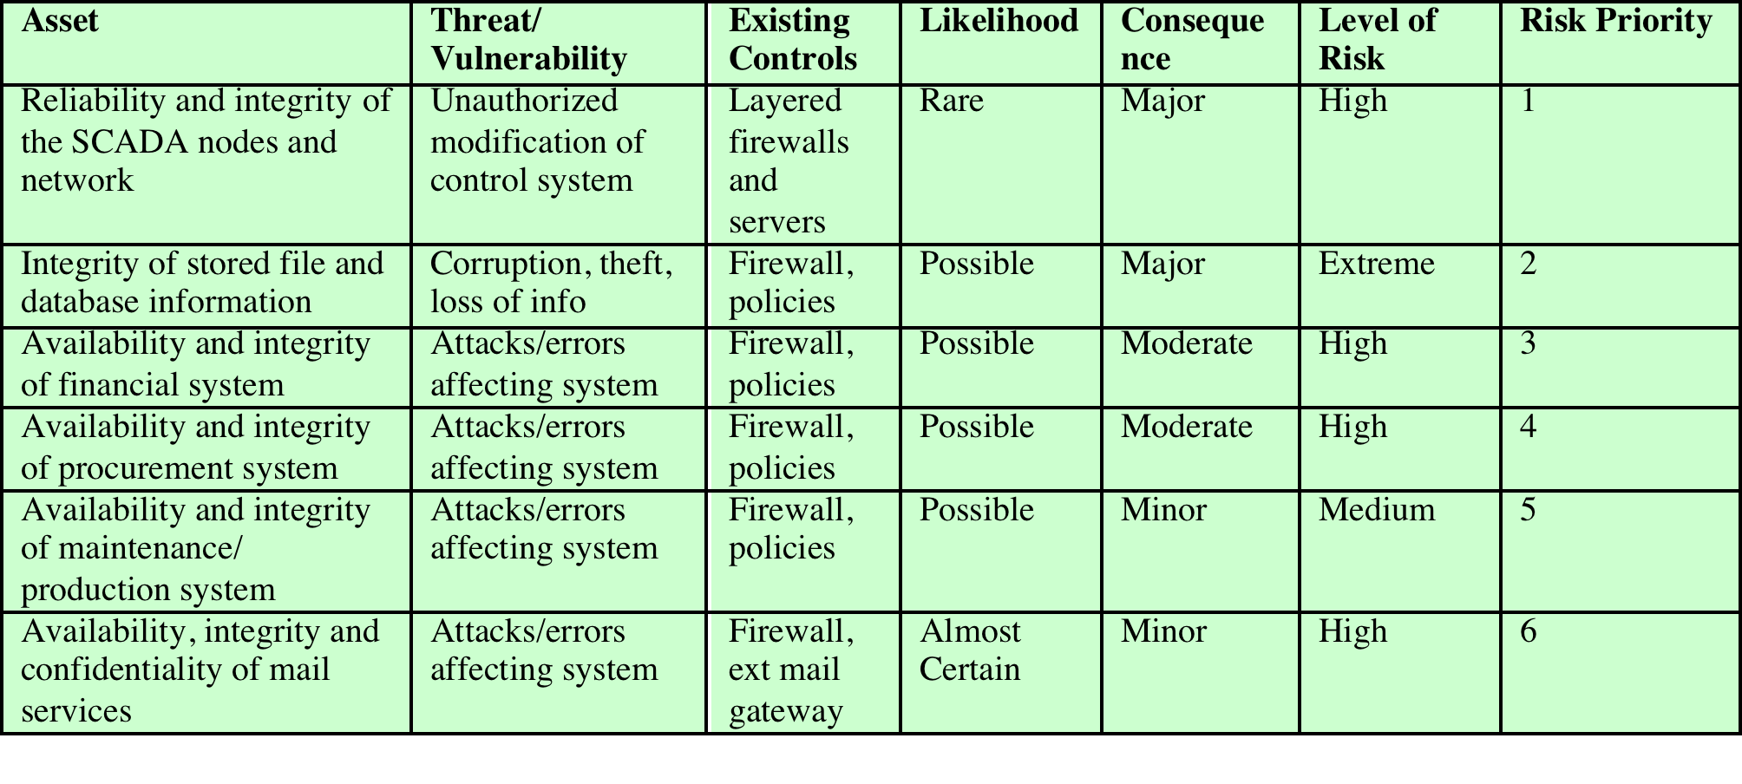
Table 14.6 Silver Star Mines Risk Register
(Table is on page 482 in textbook)
Notes:
Lastly, the analyst identified e-mail as a key asset, as a result of interviews with
all business areas of the company. The use of e-mail as a business tool cuts across
all business areas. Around 60% of all correspondence is in the form of e-mail, which
is used to communicate daily with head office, other business units, suppliers, and
contractors, as well as to conduct a large amount of internal correspondence. E-mail
is given greater importance than usual due to the remote location of the company.
Hence the collective availability, integrity, and confidentiality of mail services was
listed as a key asset.
This list of key assets is seen in the first column of Table 14.6, which is the risk
register created at the conclusion of this risk assessment process.
Having determined the list of key assets, the analyst needed to identify significant
threats to these assets and to specify the likelihood and consequence values.
The major concern with the SCADA asset is unauthorized compromise of nodes
by an external source. These systems were originally designed for use on physically
isolated and trusted networks and hence were not hardened against external
attack to the degree that modern systems can be. Often these systems are running
older releases of operating systems with known insecurities. Many of these systems
have not been patched or upgraded because the key applications they run
have not been updated or validated to run on newer OS versions. More recently,
the SCADA networks have been connected to the company’s intranet to provide
improved management and monitoring capabilities. Recognizing that the SCADA
nodes are very likely insecure,
these connections are isolated from the company
intranet by additional firewall and proxy server systems. Any external attack would
have to break through the outer company firewall, the SCADA network firewall,
and these proxy servers in order to attack the SCADA nodes. This would require
a series of security breaches. Nonetheless, given that the various computer crime
surveys suggest that externally sourced attacks are increasing and known cases of
attacks on SCADA networks exist, the analyst concluded that while an attack was
very unlikely, it could still occur. Thus a likelihood rating of Rare was chosen. The
consequence of the SCADA network suffering a successful attack was discussed
with the mining engineers. They indicated that interference with the control system
could have serious consequences as it could affect the safety of personnel in the
mine. Ventilation, bulk cooling, fire protection, hoisting of personnel and materials,
and underground fill systems are possible areas whose compromise could lead to a
fatality. Environmental damage could result from the spillage of highly toxic materials
into nearby waterways. Additionally, the financial impact could be significant,
as downtime is measured in tens of millions of dollars per hour. There is even a
possibility that Silver Star’s mining license might be suspended if the company was
found to have breached its legal requirements. A consequence rating of Major was
selected. This results in a risk level of High.
The second asset concerned the integrity of stored information. The analyst
noted numerous reports of unauthorized use of file systems and databases in
recent computer crime surveys. These assets could be compromised by both internal
and external sources. These can be either the result of intentional malicious or
fraudulent acts, or the unintentional deletion, modification, or disclosure of information.
All indications are that such database security breaches are increasing and
that access to such data is a primary goal of intruders. These systems are located
on the company intranet and hence are shielded by the company’s outer firewall
from much external access. However, should that firewall be compromised or an
attacker gain indirect access using infected internal systems, compromise of the
data was possible. With respect to internal use, the company had policies on the
input and handling of a range of data, especially that required for audit purposes.
The company also had policies on the backup of data from servers. However, the
large number of systems used to create and store this data, both desktop and server,
meant that overall compliance with these policies was unknown. Hence a likelihood
rating of Possible was chosen. Discussions with some of the company’s IT managers
revealed that some of this information is confidential and may cause financial harm
if disclosed to others. There also may be substantial financial costs involved with
recovering data and other activities subsequent to a breach. There is also the possibility
of serious legal consequences if personal information was disclosed or if the
results of statutory tests and process information were lost. Hence a consequence
rating of Major was selected. This results in a risk level of Extreme.
The availability or integrity of the key Financial, Procurement, and
Maintenance/Production systems could be compromised by any form of attack
on the operating system or applications they use. Although their location on the
company intranet does provide some protection, due to the nature of the company
structure a number of these systems have not been patched or maintained for some
time. This means at least some of the systems would be vulnerable to a range of network
attacks if accessible. Any failure of the company’s outer firewall to block any
such attack could very likely result in compromise of some systems by automated
attack scans. These are known to occur very quickly, with a number of reports indicating
that unpatched systems were compromised in less than 15 minutes after network
connection. Hence a likelihood of Possible was specified. Discussions with
management indicated that the degree of harm would be proportional to extent and
duration of the attack. In most cases a rebuild of at least a portion of the system
would be required, at considerable expense. False orders being issued to suppliers
or the inability to issue orders would have a negative impact on the company’s reputation
and could cause confusion and possible plant shutdowns. Not being able to
process personnel time sheets and utilize electronic funds transfer and unauthorized
transfer of money would also affect the company’s reputation and possibly result in
a financial loss. The company indicated that the Maintenance/Production system’s
harm rating should be a little lower due the ability of the plant to continue to operate
despite some compromise of the system. It would, however, have a detrimental
impact on the efficiency of operations. Consequence ratings of Moderate and
Minor, respectively, were selected, resulting in risk levels of High or Medium.
The last asset is the availability, integrity, and confidentiality of mail services.
Without an effective e-mail system, the company will operate with less efficiency. A
number of organizations have suffered failure of their e-mail systems as a result of
mass e-mailed worms in past years. New exploits transferred using e-mail are reported.
Those exploiting vulnerabilities in common applications are of major concern. The
heavy use of e-mail by the company, including the constant exchange and opening of
e-mail attachments by employees, means the chance of compromise, especially by a
zero-day exploit to a common document type, is very high. While the company does filter
mail in its Internet gateway, there is a high probability that a zero-day exploit would
not be caught. A denial of service attack against the mail gateway is very hard to defend
against. Hence a likelihood rating of Almost Certain was selected in recognition of the
wide range of possible attacks and the high chance that one will occur sooner rather
than later. Discussions with management indicated that while other possible modes of
communication exist, they do not allow for transmission of electronic documents. The
ability to obtain electronic quotes is a requirement that must be met to place an order
in the purchasing system. Reports and other communications are regularly sent via this
e-mail, and any inability to send or receive such reports might affect the company’s
reputation. There would also be financial costs and time needed to rebuild the e-mail
system following a serious compromise. Because compromise would not have a large
impact, a consequence rating of Minor was selected. This results in a risk level of High.
The information was summarized and presented to management. All of the
resulting risk levels are above the acceptable minimum management specified as
tolerable. Hence treatment is required. Even though the second asset listed had the
highest level of risk, management decided that the risk to the SCADA network was
unacceptable if there was any possibility of death, however remote. Additionally, the
management decided that the government regulator would not look favorably upon a
company that failed to rate highly the importance of a potential fatality. Consequently,
the management decided to specify the risk to the SCADA as the highest priority for
treatment. The risk to the integrity of stored information was next. The management
also decided to place the risk to the e-mail systems last, behind the lower risk to the
Maintenance/Production system, in part because its compromise would not affect the
output of the mining and processing units and also because treatment would involve
the company’s mail gateway, which was outside the management’s control.
The final result of this risk assessment process is shown in Table 14.6, the resulting
overall risk register table. It shows the identified assets with the threats to them,
and the assigned ratings and priority. This information would then influence the selection
of suitable treatments. Management decided the first five risks should be treated
by implementing suitable controls, which would reduce either the likelihood or the
consequence should these risks occur. This process is discussed in the next chapter.
None of these risks could be accepted or avoided. Responsibility for the final risk
to the e-mail system was found to be primarily with the parent company’s IT group,
which manages the external mail gateway. Hence the risk is shared with that group.

Slide 36
Summary
IT security management
Organizational context and security policy
Security risk assessment
Baseline approach
Informal approach
Detailed risk analysis
Combined approach
Detailed security risk analysis
Context and system characterization
Identification of threats/risks/vulnerabilities
Analyze risks
Evaluate risks
Risk treatment
Case study: Silver Star Mines
Notes:
Chapter 14 summary.

